Slide 1

LIVE SESSION · LITERATURE REVIEW
From Paper Search to Research Gap
Search → Screen → Read → Track → Compare → Synthesise
Finding, screening, tracking, and synthesising research papers to make defensible thesis decisions.
MD. SABBIR AHMED
AI/ML THESIS TRACK · PHITRON
SESSION 02

Slide 2
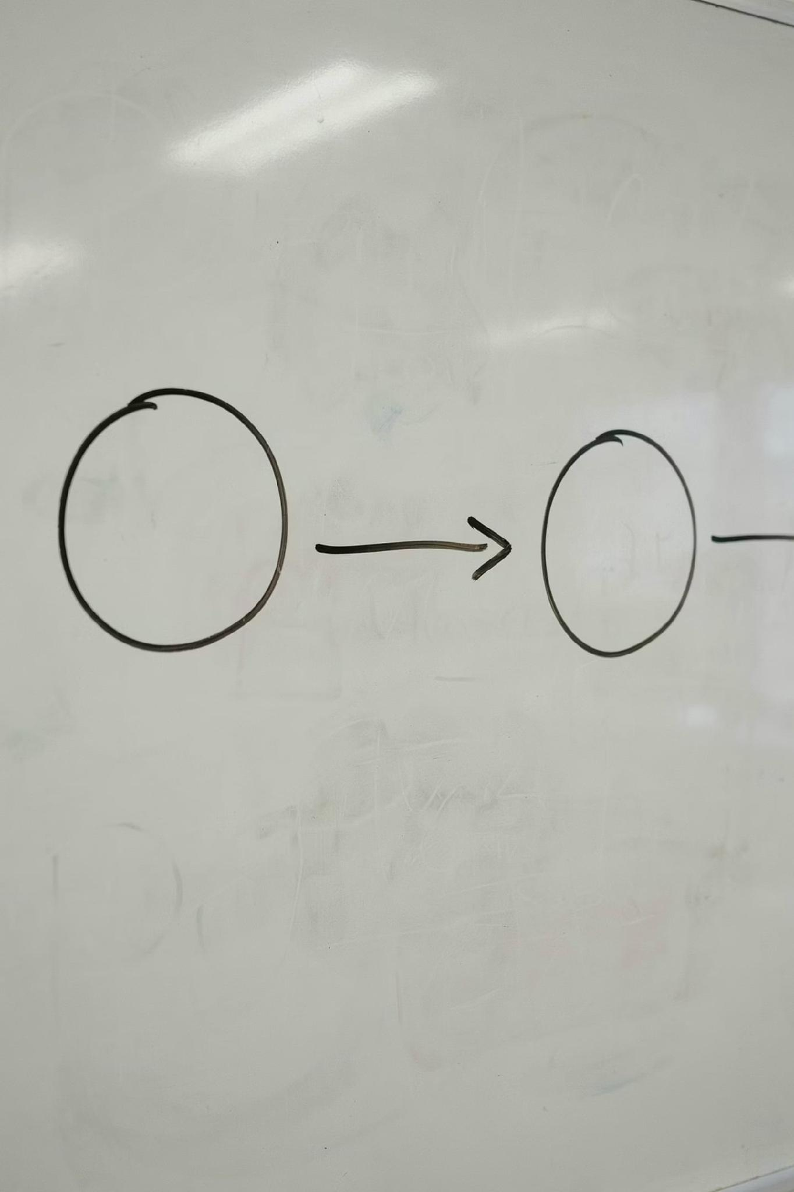

CONTINUITY
Where We Are Now
Previous Session
Today's Goal
Generated several topic ideas
Reduced them to three candidate topics
Checked problem, dataset, feasibility, and contribution
Used SPOT to test early topic directions
Use literature to refine, compare, strengthen, or reject those candidate topic ideas.
The literature is not decoration. It is evidence for a research decision. A topic idea becomes stronger only when the literature supports a clear gap.

Slide 3
OUTCOMES
What You Should Leave With
1
Search Keywords
Turn a research problem into targeted search terms
2
LLM-Assisted Search
Use LLMs to improve search terms and Boolean strings
3
Find & Screen
Locate and screen relevant papers efficiently
4
Anchor Papers
Identify anchor and supporting papers
5
Extract Evidence
Pull structured evidence using the tracker
6
Gaps vs Limits
Distinguish paper limitations from research gaps
7
Synthesise
Synthesise findings across multiple papers
8
Topic Decision
Use literature to select the strongest topic direction

Slide 4
FINDING PAPERS
Break the Topic Into Search Blocks
Students usually search the full thesis title once. That is a weak strategy. Search by individual concepts and combine them.
Example Combinations
Search Block
Example
"SMS phishing" AND detection
Bangla AND phishing AND dataset
"code-mixed text" AND scam detection
"phishing detection" AND explainability
Problem
Phishing-message detection
Context
Bangla-speaking users
Data
SMS, text messages, screenshots
Do not search only with the proposed thesis title. Search with different combinations of the main concepts.
Method / Concern
Transformer, code-mixing, explainability

Slide 5

FINDING PAPERS
Use an LLM to Generate Search Keywords
Ask the LLM for:
Example Prompt
Main research concepts
Synonyms and alternative terms
Broader and narrower keywords
Context-specific keywords
Dataset-related keywords
Boolean search strings
My research problem is early identification of students at risk in introductory programming courses using attendance, lab submissions, and assessment activity. Generate key concepts, synonyms, broad and narrow keywords, five Boolean search strings, and keywords for finding datasets and systematic reviews.
Possible Output Terms
Use the LLM to design the search. Do not use it as the literature database.
Student-risk prediction · early-warning systems · academic-performance prediction · learning analytics · CS1 · introductory programming · lab submissions · LMS data · assessment behaviour

Slide 6


FINDING PAPERS
What LLMs Should Not Do
Do Not Rely on an LLM to:
Required Verification for Every Paper
Give a final paper list without verification
Generate references that have not been checked
Claim that a research gap exists
Summarise a paper that was not provided
Report datasets, methods, or results from memory
Decide that no previous study exists
Search the exact title
Confirm authors, venue, and year
Open the actual paper
Check DOI or official publication page
Read the relevant sections yourself
Record evidence in the tracker
LLMs can support search. They cannot replace source verification.

Slide 7



FINDING PAPERS
Search Strings Should Evolve
Start broad, then narrow progressively. The first search query should never be the final search query.
Start Broad
Add Context
Search Data
"Student performance prediction" — finds terminology and review papers
Narrow by population, language, or setting: "introductory programming" AND learning analytics
Look for datasets, benchmarks, and baselines: "student risk prediction" AND lab submissions AND dataset

Slide 8


FINDING PAPERS
Use the Paper Discovery Chain
Search Query
Useful Paper
References
Cited By
Related Papers
When you find one strong anchor paper, use it to find several more. Check its references, who has cited it, and which papers are listed as related. Suggested sources: Google Scholar, ACM Digital Library, IEEE Xplore, Scopus, ScienceDirect, SpringerLink, arXiv.
Do not stop at the first search result page. Follow the paper network.

Slide 9

SCREENING
Do Not Read Every Paper Fully
Five-Minute Screening Process
Screening Questions
01
Is the problem relevant?
Is the context comparable?
Is the data relevant?
Does it help with method or evaluation?
Is the full paper accessible?
Is the method described clearly?
Read the title
02
Read the abstract
03
Check the introduction
04
Inspect tables and figures
Finding a paper does not mean it belongs in the literature review.
05
Read the conclusion
06
Include, exclude, or mark as background

Slide 10

SCREENING
Classify the Papers
Anchor Paper
Supporting Paper
Closest to the proposed work in problem, context, dataset, method, or evaluation. These are your primary comparisons.
Useful for one component — dataset, method, metric, explainability, ethics, fairness, or deployment.
Background Paper
Explains the broader area but is not a close technical comparison.
Ten broad background papers cannot replace three strong anchor papers.

Slide 11




READING
Read Papers in Three Passes
Pass 3 — Critical Reading
Pass 2 — Evidence Extraction
Pass 1 — Relevance
Dataset suitability, fair comparison, metrics, data leakage, supported claims, and reproducibility.
What is the study about? Should we keep it? Decide quickly before investing time.
Problem, data, inputs, method, baselines, evaluation, and results. Fill in the tracker.
Do not read passively. Read to answer tracker questions and to compare papers later.

Slide 12
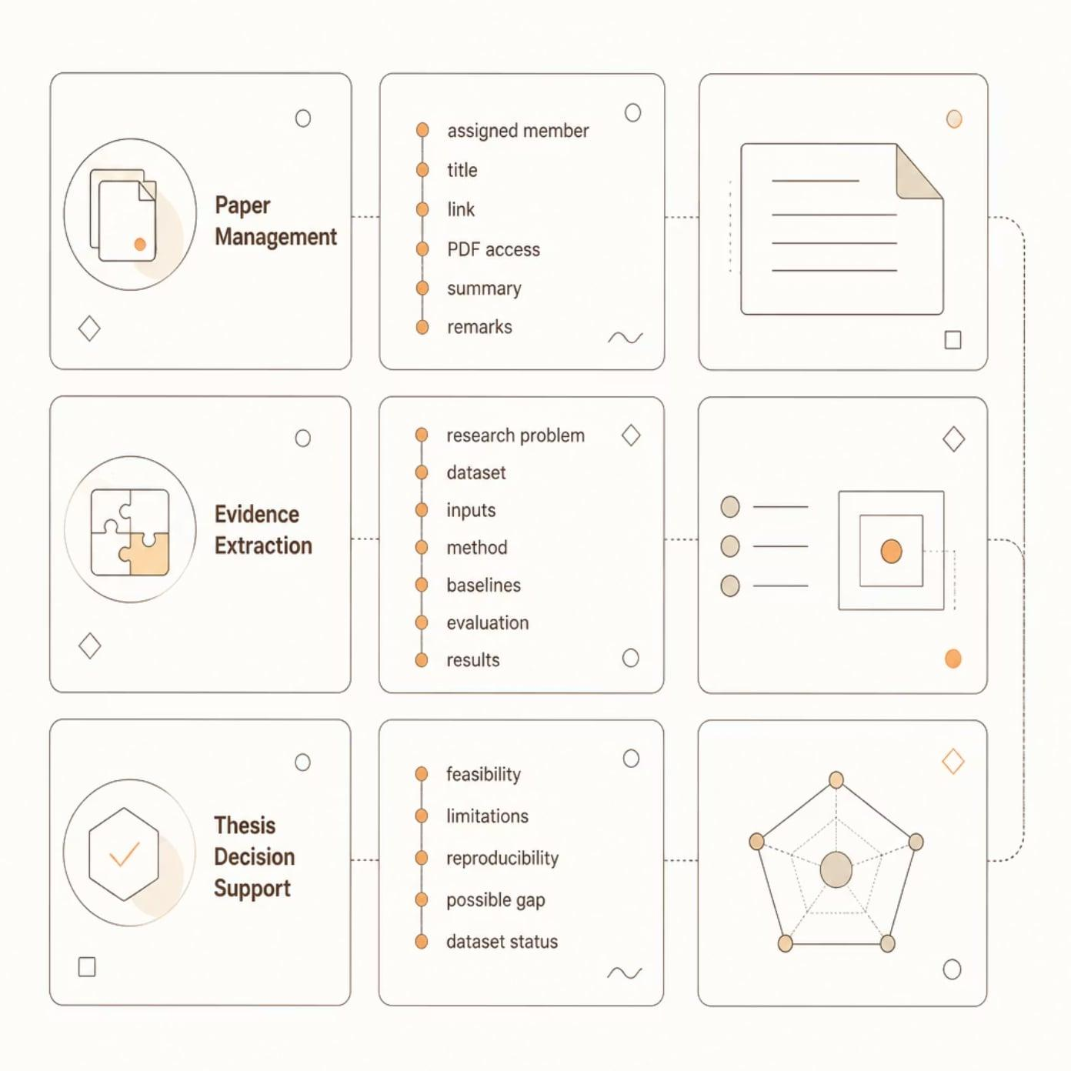
USING THE TRACKER
What the Tracker Does
Why It Matters
Without a tracker, paper notes remain scattered and incomparable. The tracker imposes a consistent structure so that evidence from ten different papers can be placed side by side.
The tracker converts separate papers into comparable evidence. Tracker Link

Slide 13
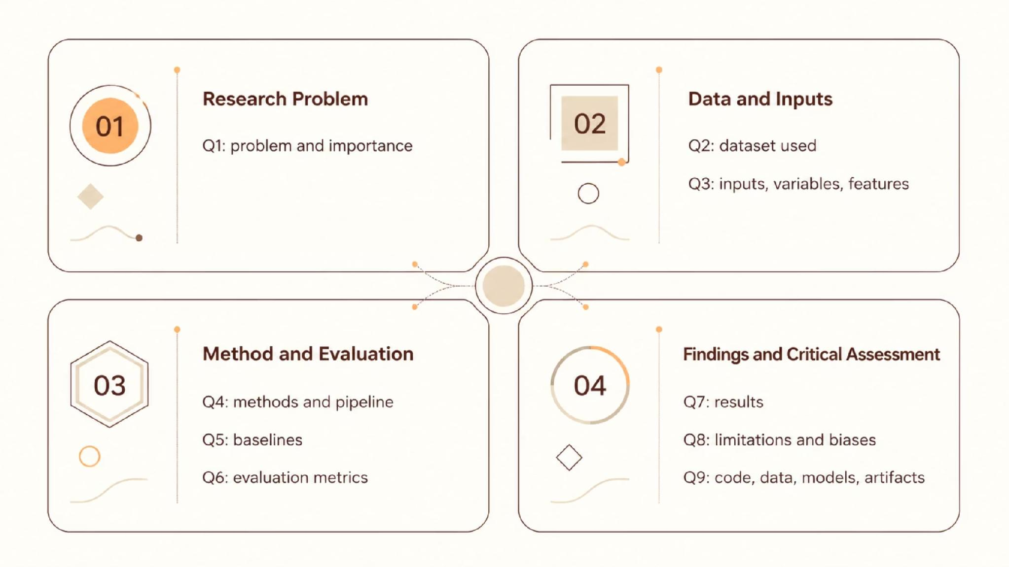
USING THE TRACKER
Q1–Q9 as an Evidence Map
Q1–Q7 explain what was done. Q8 and Q9 help decide what remains weak, missing, or difficult to reproduce — the foundation for identifying genuine research gaps.

Slide 14

USING THE TRACKER
Live Tracker Walkthrough
Example: Interpretable lung-cancer detection from symptom data.
Tracker Field
What Was Extracted
Problem
Interpretable lung-cancer detection from symptom data
Dataset
Kaggle symptom dataset — small, imbalanced, deduplicated
Method
Deduplication, encoding, SMOTE, DT, LR, RF, NB, SHAP, LIME
Evaluation
Accuracy, precision, recall, F1 — no external validation reported
Limitation
Small sample, self-reported symptoms, class imbalance, code not released
Possible Gap
Need stronger validation and richer clinical evidence
Record enough detail to compare this paper with other studies later.

Slide 15

GAP SYNTHESIS
Limitation, Gap, and Direction Are Different
Paper Limitation
Research Gap
Possible Direction
Tested only on clean images
Field-condition robustness remains unclear
Evaluate under blur, poor light, and clutter
Data from one university
Cross-institution generalisability is unknown
Conduct external validation
Only accuracy reported
Minority-class performance is unclear
Use recall, F1, and class-wise analysis
No user evaluation
Usefulness of explanations is unknown
Conduct expert or user evaluation
A limitation describes one study. A gap describes an unresolved issue supported by multiple studies.

Slide 16
GAP SYNTHESIS
How to Synthesise Across Papers
Synthesis Questions
01
❌ Weak Writing
What has generally been studied?
Paper A used CNN. Paper B used ResNet. Paper C used MobileNet. Paper D achieved 96% accuracy.
02
Which data, methods, or contexts dominate?
03
What do studies collectively find?
✅ Better Synthesis
04
Existing studies report strong plant-disease classification performance using CNN-based models on curated image datasets. However, most evaluate models using clean images from the same benchmark source, providing limited evidence of robustness under poor lighting, blur, partial visibility, and background clutter.
Which limitation appears repeatedly?
05
Why does it matter?
06
What research direction follows?

Slide 17
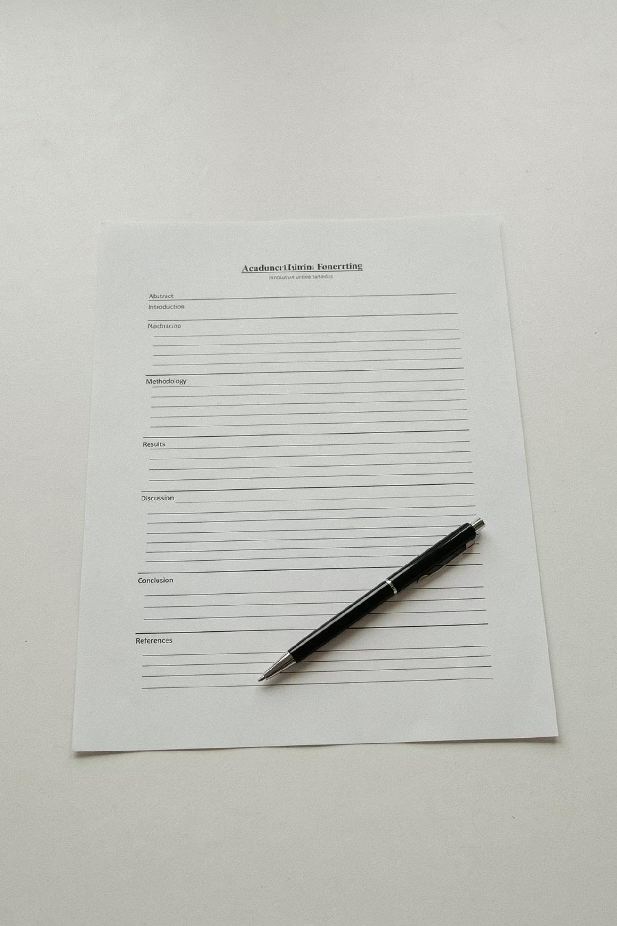


GAP SYNTHESIS
Gap Synthesis Scaffold
Existing studies primarily investigate [problem] using [common datasets, methods, or contexts]. While they generally report [main findings], evidence remains limited regarding [recurring unresolved issue]. This matters because [practical or scientific consequence]. Therefore, further research should investigate [specific direction] using [appropriate data and evaluation approach].
⚠ Do not claim "no study exists"
Only make this claim after an exhaustive, well-documented search.
⚠ Do not echo author-suggested future work
Author suggestions are not confirmed gaps — they require independent validation across multiple papers.
Use this as a thinking scaffold. Do not copy it mechanically into the thesis.

Slide 18

POST-SESSION TASK
Apply Today's Process After the Session
Step 1 — Test All Three Topics
Step 2 — Select the Strongest Topic
Step 3 — Expand the Review
For each candidate topic, find three closely related papers and one anchor paper. Compare problem, data, method, evaluation, results, and limitations.
Choose the topic with a clearer unresolved problem, accessible data, feasible method direction, suitable evaluation, and an explainable contribution.
For the preferred topic, expand to 5–7 papers, complete the tracker thoroughly, identify recurring limitations, write one gap synthesis, and keep one backup topic.
Do not choose a topic first and then search for papers that support it. Use the literature to decide which topic deserves to continue.

Slide 19
POST-SESSION TASK
Expected Output Before Supervisor Review
Submit This Evidence Package
What a Strong Submission Says
Three candidate topics
Three-paper comparison for each topic
Five to seven papers for the preferred topic
One gap synthesis paragraph
Preferred topic with justification
One backup topic
Questions for the supervisor
"These papers show what has been done, what remains unresolved, which topic is feasible, and why our selected direction is defensible."
The supervisor meeting should be used for decisions, not for basic guessing about whether a topic is valid.

